Slide 1


Movie Recommendation System
Samanwitha Lakkadi
801257829

Slide 2

Introduction
Recommendation Systems are a type of information filtering system that enhances the quality of search results by showing items that are more relevant to the search item or are related to the user's past searches. They're used to forecast how a person would evaluate or prefer a certain item.

Slide 3

Motivation
Netflix and Spotify, for example, rely heavily on the effectiveness of their recommendation engines to drive their growth and success. I feel that recommendation systems would have a significant influence on application access and usage, and it is critical that the user maintains interest in the application. We need to display people trending information or stuff that they could enjoy in order to keep them interested in our app. This is precisely why I set out to create this method.

Slide 4


PROBLEM STATEMENT
In this project I am going to build a system for recommendations based on demographic, content, collaborative filtering.

Slide 5

Dataset information
The dataset used in this system has various features required to define different details about the movies like genres, id, keywords, overview, popularity, production_companies, production_countries, vote_average, vote_count, cast, crew

Slide 6

Demographic filtering
Provides users with generic suggestions based on movie popularity/scores assigned by weighting certain aspects of the film. Because each user is unique, this technique is deemed too simplistic. The primary premise of this method is that films that are more popular and highly acclaimed are more likely to be loved by the general public.

Slide 7
Demographic filtering Implementation
Weighted Rating(WR) = (v/(v+m) * R) +(m/(v+m) * C)
1. Using IMDB’s Weighted Rating
v - Number of votes for the movie m - Minimum votes required to be considered for recommendation. R - Average rating of the movie; C - Mean vote across the whole data

Slide 8
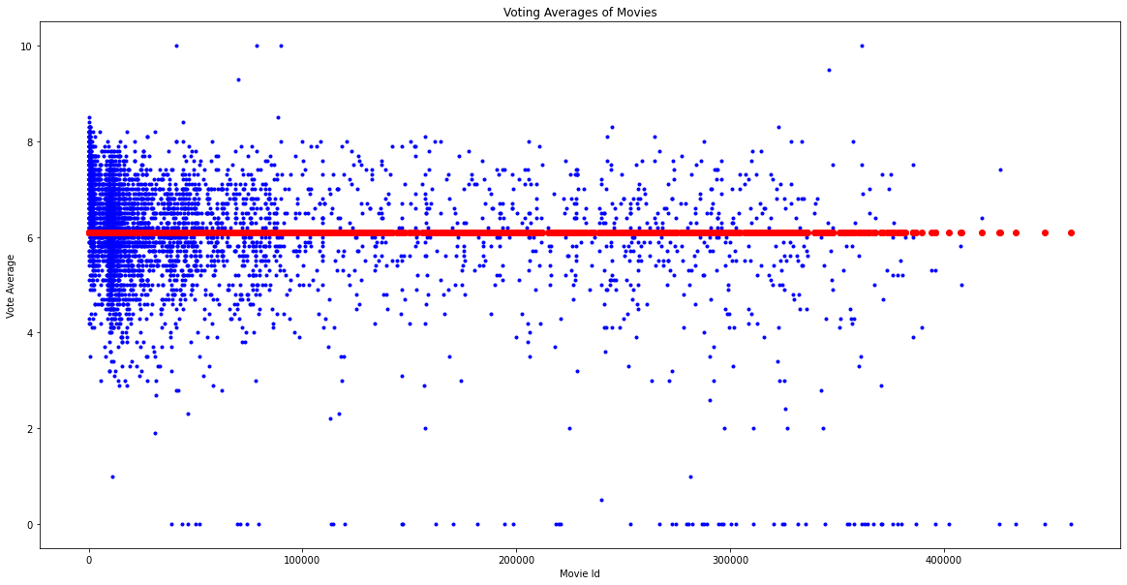
The plot represents each movie and the voting (blue dot) of that movie on a scale of 10 along with the mean vote(red o) of the entire dataset.

Slide 9
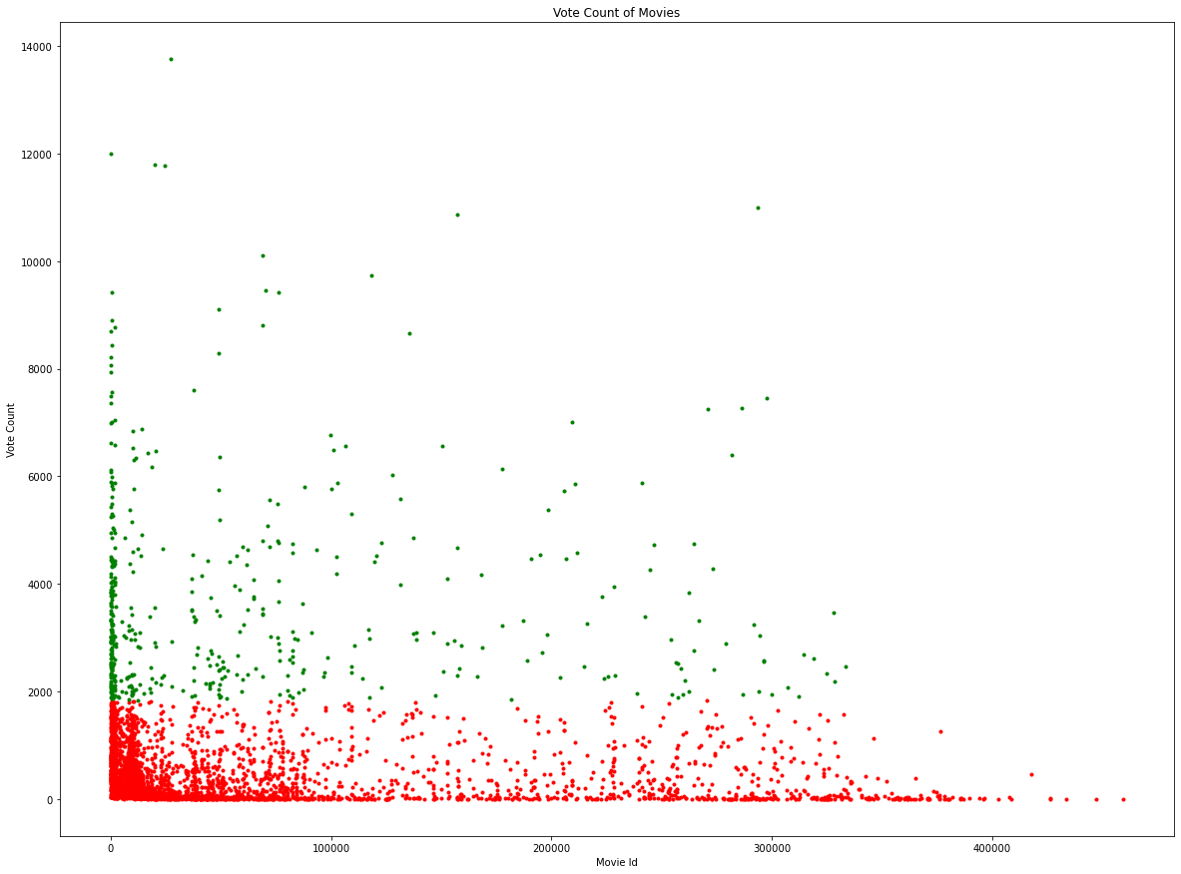
Using 90 percentile as our cutoff for min number of votes required for a movie to be considered for the recommendation i.e for a movie to be filtered for the recommendation, it must have more votes than at least 90% of the movies in the list.
The green dots represent the movie ids that are in the 90 percentile criteria whereas the red ones represent the ids that aren’t.

Slide 10
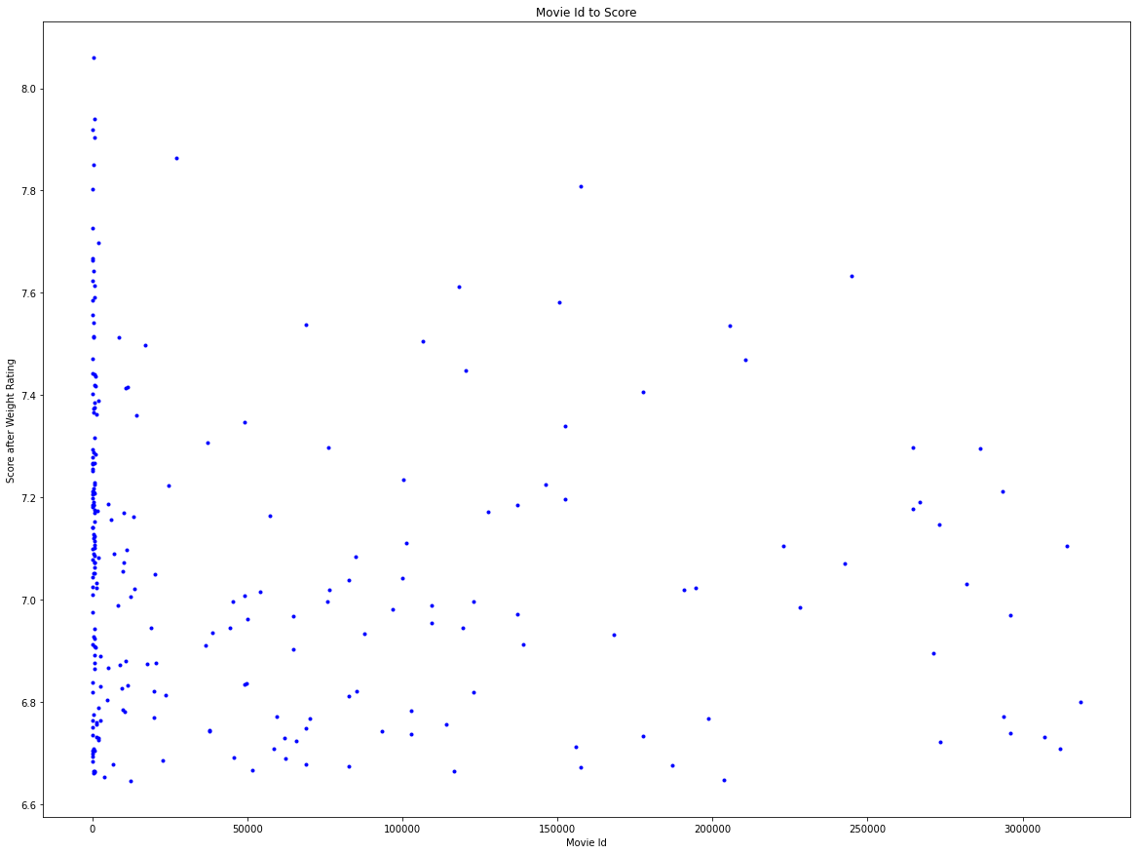
After calculating the scores by applying the mentioned IMDB’s weight rating formula using the voting averages, count and mean, the movies are ordered according to their scores from highest to lowest and could be filtered for any number of top movies for trending recommendations.

Slide 11
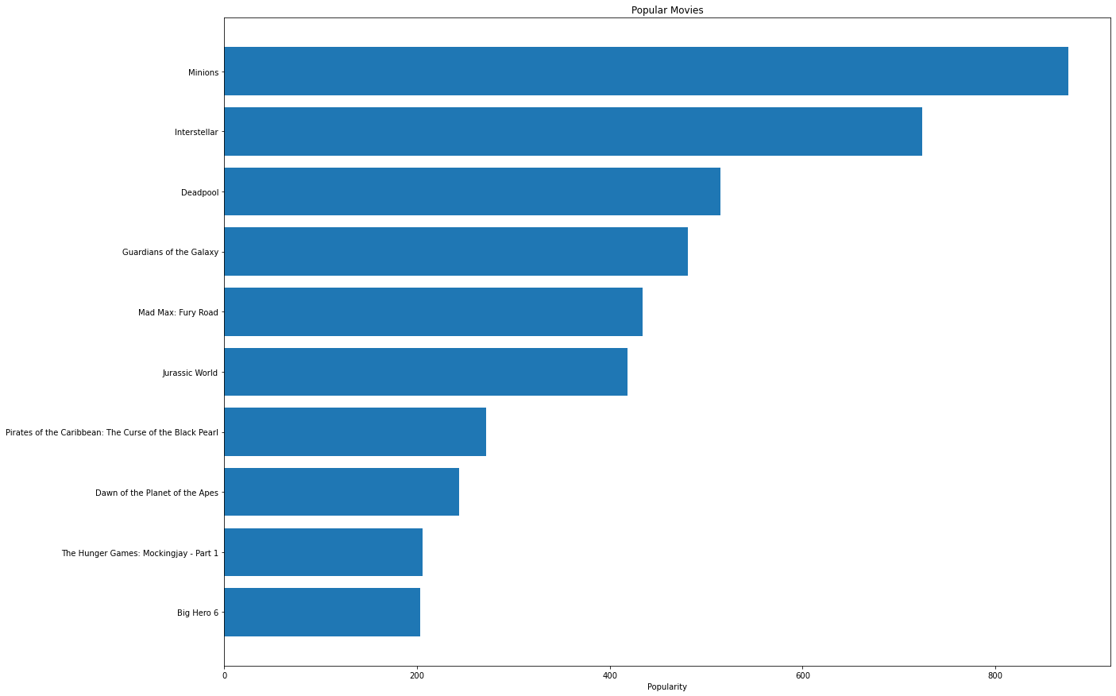
Demographic filtering Implementation
2. Using popularity feature of the dataset
Movies can be directly sorted based on the field ‘popularity’ that is already present in the dataset and could be used for getting any number of popular movies for recommendation.

Slide 12
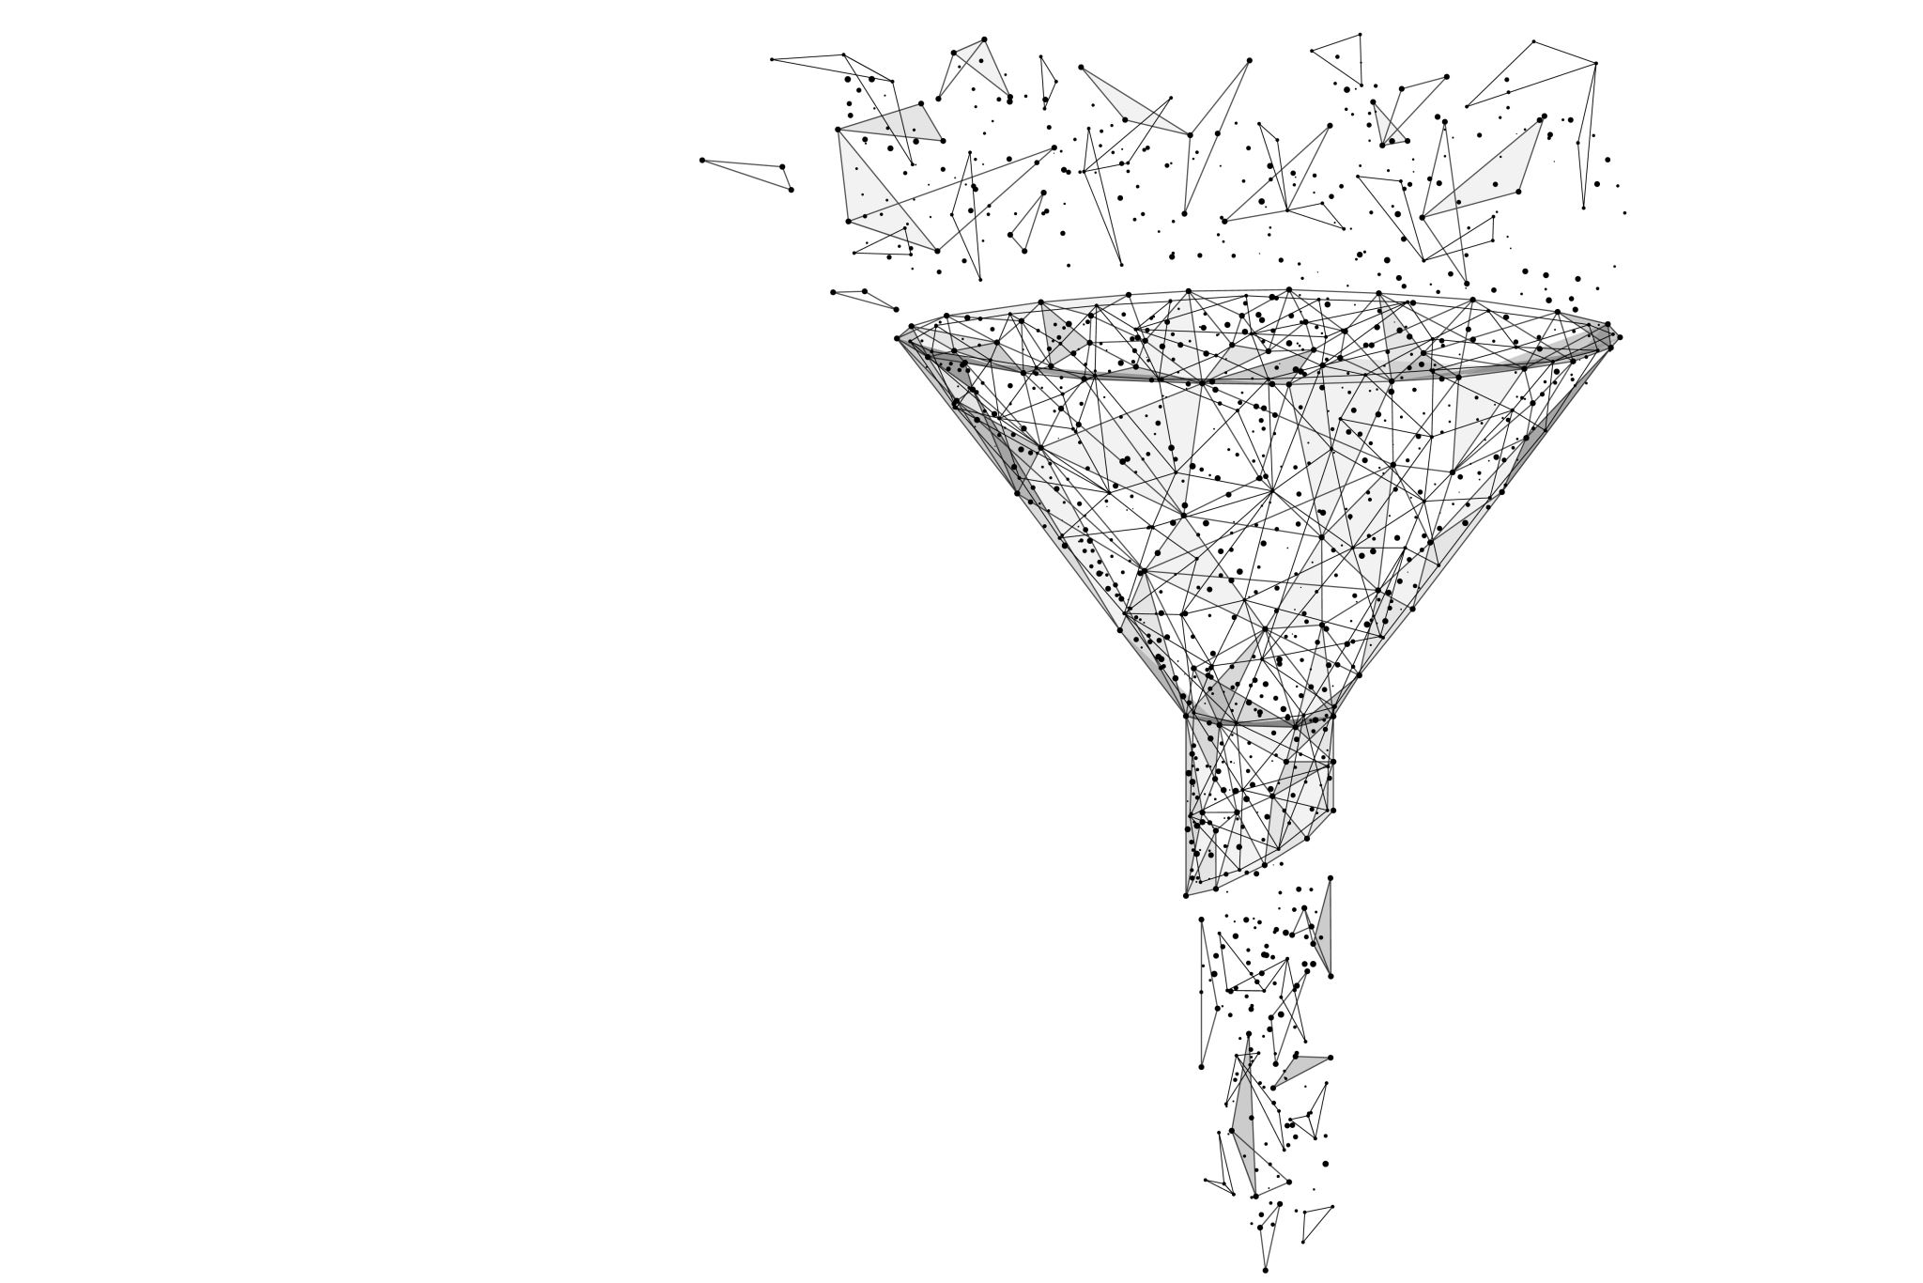
Content Based Filtering
The metadata like story/plot, cast, crew, keyword are used to find similarity of a movie to other movies. Then the movies that are most likely to be similar are recommended.

Slide 13
Content Based Filtering Implementation
1. Story-based filtering
We are using Term Frequency-Inverse Document Frequency (TF-IDF) vectors for story of each movie.
Term frequency(TF) - Relative frequency of a word in a document. Inverse Document Frequency(IDF) - Relative count of documents containing the term.
Each word's total value to the papers in which it appears is equal to TF * IDF. This will produce a matrix in which each column represents a word in stories whereas each row represents a movie.
This is done to lower the value of terms that appear often in plot overviews, and hence their impact in calculating the final similarity score.

Slide 14
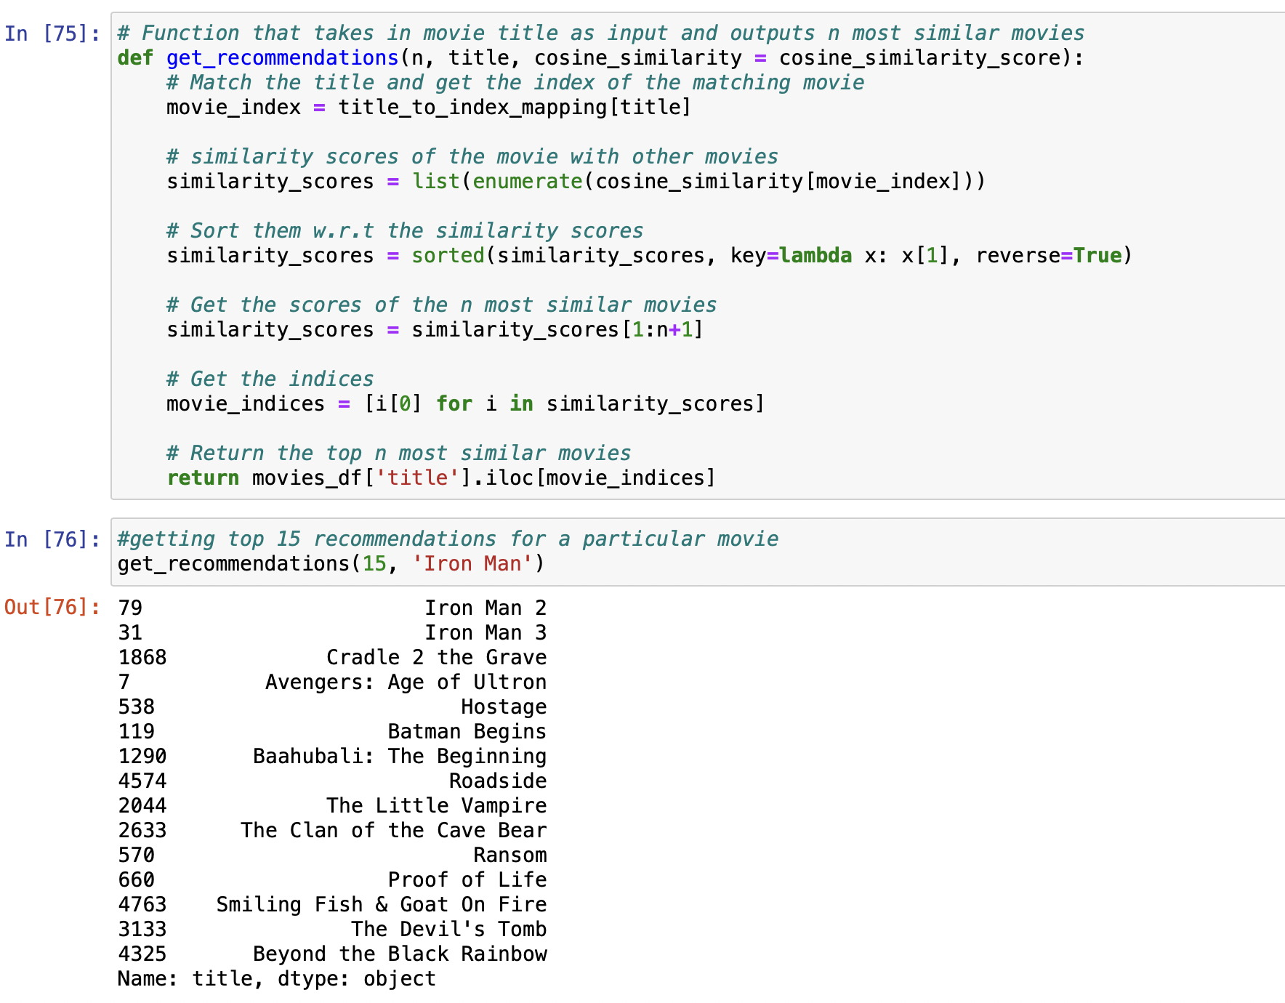
We'll utilize the linear_kernel() function of sklearn's on the output matrix from the TF-IDF vectorizer to get the similarity scores.
We need a technique to identify the index of a movie in our metadata Data Frame given its title in order to develop a function that takes a movie title as an input and generates a list of the n most comparable movies; thus, we map the movie title to the indices for retrieval based on titles.

Slide 15
Content Based Filtering Implementation
2. Metadata based filtering
We extract the features required like the director, top three cast members, genres keywords of the movie and generate a similarity score for the features and get the movies similar corresponding to the features mentioned.
One important difference between the plot and metadata-based recommender is that we use the Count Vectorizer instead of TF-IDF.

Slide 16
We just count the number of times a word appears in the document using Count Vectorizer, which results in a bias in favor of the most common terms. This is because we don't want to undervalue an actor's or director's presence just because he or she has been in or directed in a larger number of films.
We may add some more features, such as production house, because for example, fans of Marvel or DC comics are more likely to enjoy films produced by the same studio.

Slide 17

COLLABORATIVE FILTERING
Our content-based engine has several serious limitations. It can only recommend films that are similar to a certain film. That is, it is incapable of collecting tastes and making genre-specific recommendations.
Also, the engine we created isn't truly personal because it doesn't account for a user's particular preferences and prejudices. Regardless of who is asking our engine for suggestions based on a movie, everyone will receive the same recommendations for that movie.

Slide 18
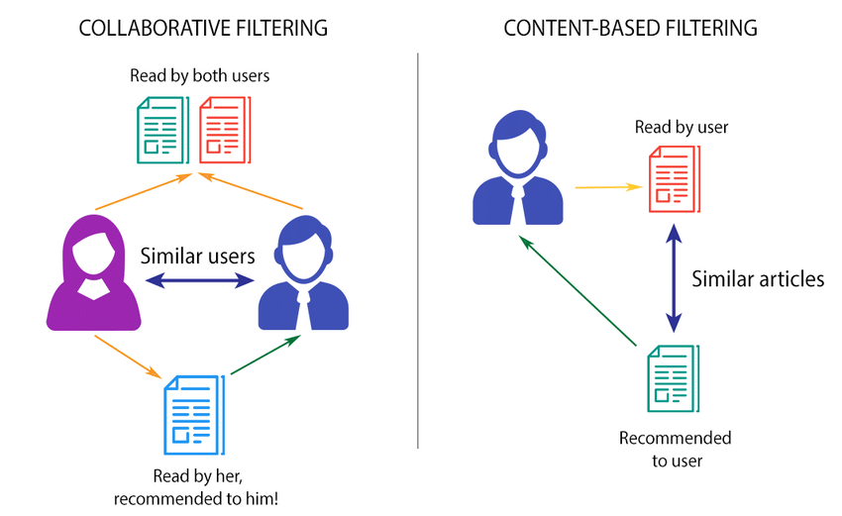

Slide 19

Collaborative Filtering is based on the premise that individuals with similar tastes to a certain person may be used to estimate how much that person would enjoy a product or service that they have used but that the person has not yet utilized.
I utilized the Surprise library, which employed incredibly sophisticated techniques like as Singular Value Decomposition (SVD) to reduce RMSE (Root Mean Square Error) and provide excellent suggestions.

Slide 20
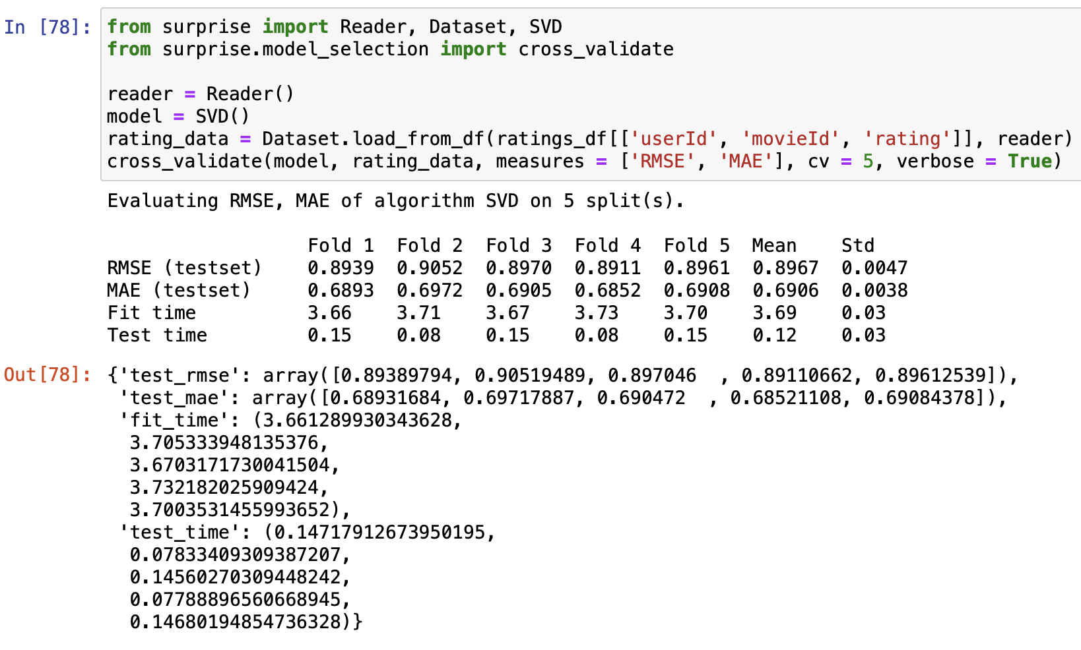
New dataset with features UserId, MovieId, Rating.
Load the data into a Reader and evaluate the SVD model for the data using the cross_validate function.
The mean Root Mean Square Error is around 0.89, which is more than enough in our instance.

Slide 21
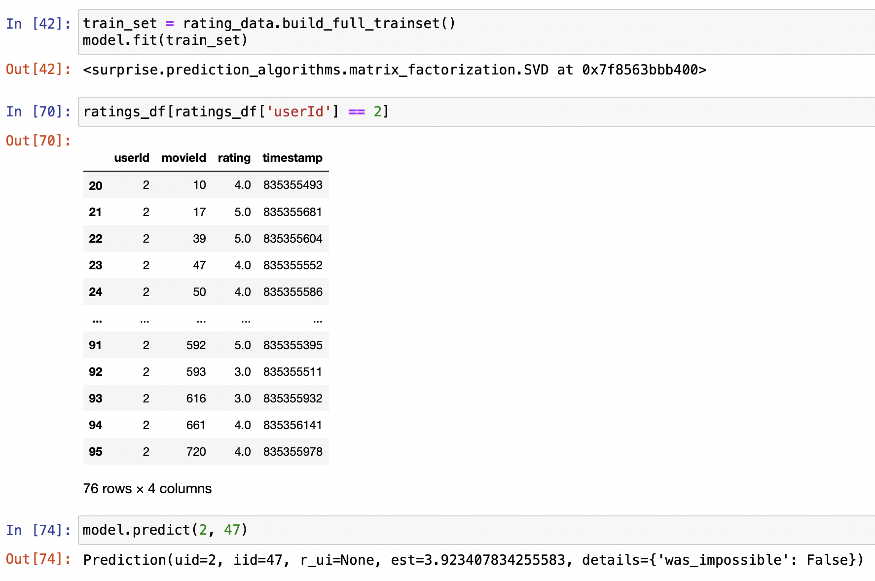
After fitting the data with the SVD model, we check the ratings given by the UserId 2 for different movies.
If we predict the rating that would be given by the UserId 2 for the MovieId 47 we got the estimated dating as 3.923 which is close to the actual rating given by the user i.e., 4.0 which can be referenced from the given data.

Slide 22
Conclusion & future work
I have tried to build a recommendation system that tries to predict the ratings that could be given for a movie by a particular user.
In the future, we could build a hybrid model that takes all the demographics, content as well as the user preferences into account before giving out the recommendations.

Slide 23
References
Ching-Seh Mike Wu, Deepti Garg, Unnathi Bhandary, “Movie Recommendation System Using Collaborative Filtering, 2018”
Chang Cai, Li Wang, “Application of improved k-means k-nearest neighbor algorithm in the movie recommendation system, 2020”
Content based filtering from https://medium.com/web-mining-is688-spring-2021/content-based-movie-recommendation-system-72f122641eab
https://hackernoon.com/introduction-to-recommender-system-part-1-collaborative-filtering-singular-value-decomposition-44c9659c5e75

Slide 24
THANKS!!

